Slide 1



CAPSTONE PROJECT
Instamart Sales and Customer Behavior Analysis using Power BI
Presented By
Student Name: BIKKUMALLA SHIVA CHARAN
College Name: Vignana Bharathi Institute of Technology
Department: CSE (ai & ML)
Email ID: b.shivacharan9963@gmail.com

Slide 2
OUTLINE:
Problem Statement (Should not include solution)
Proposed System/Solution
System Development Approach (Technology Used)
Algorithm & Deployment
Result (Output Image)
Conclusion
Future Scope
References

Slide 3
Problem Statement:
Example: Instamart is an online grocery delivery platform that receives many customer orders every day across different product categories. Because of the large amount of order data, it becomes difficult for the company to manually understand customer purchasing patterns and product demand. This may lead to problems like poor inventory management and difficulty identifying popular products and peak order times. Therefore, a data-driven analysis system is needed to study the order data. In this project, a Power BI dashboard is created to analyze sales trends, customer behavior, and reorder patterns to help improve business decisions and customer experience.

Slide 4
Proposed Solution:
The proposed system focuses on analyzing Instamart grocery order data using Power BI dashboards to generate business insights.
The system performs the following steps: Data Collection
The Instamart dataset contains historical grocery order information including: Order ID, Customer ID, Product Name, Department, Aisle, Order Day, Order Hour, Reorder Information
Data Preprocessing
Before visualization, the dataset is cleaned and prepared by: Removing duplicate records, Handling missing values, Correcting data types, Filtering required columns, Creating relationships between tables
Data Analysis
Using Power BI, various analytical measures and KPIs are created such as: Total Orders, Total Customers, Total Products Sold, Reorder Rate, Average Order Size
Data Visualization
Three interactive dashboard pages are created:
Sales and Order Overview
Product and Category Analysis
Customer Behavior and Reorder Analysis
These dashboards help businesses identify important patterns and trends.

Slide 5
System Approach:
The system is developed using the following tools and technologies.
Dataset: Instamart Online Grocery Basket Analysis Dataset
The dataset contains information about: Customer orders, Product details, Departments and aisles, Reorder patterns
A cleaned dataset with 500 rows was used for this project.
Technology Used: Power BI Desktop
Power BI is used to: Import and clean the dataset, Create data relationships, Develop calculated measures using DAX, Build interactive dashboards
Data Modeling: Relationships were created between dataset fields to enable proper analysis.
Key data columns include: order_id, User_id, Product_name, department, aisle, Order day, Order hour, reordered
System Requirements:
Power BI Desktop – Used to import the dataset, create data models, apply DAX calculations, and design interactive dashboards.
Microsoft Excel / CSV Dataset – Used as the data source for storing and preparing the Instamart order dataset before importing into Power BI.
Library / Tools Required to Build the Model
Power Query Editor – Used for data cleaning, transformation, and preprocessing of the dataset.
DAX (Data Analysis Expressions) – Used to create calculated measures such as Total Orders, Reorder Rate, and Average Order Size for analysis.

Slide 6
Algorithm & Deployment:
Since this project focuses on data analytics rather than machine learning, the approach involves data modeling, DAX calculations, and dashboard visualization.
Data Input
The dataset includes the following features: Order ID, Customer ID, Product Name, Department, Aisle, Order Day of Week, Order Hour of Day, Days Since Prior Order, Reordered Flag
Data Processing
The dataset was processed using the following steps: Data Cleaning, Data Modeling, Creation of Calculated Measures using DAX, Visualization using Power BI
Important DAX Measures
Total Orders = DISTINCTCOUNT(order_id)
Total Customers = DISTINCTCOUNT(user_id)
Total Products Sold = COUNT(product_id)
Reorder Rate = Reordered Products / Total Products Sold
Average Order Size = Total Products Sold / Total Orders
Deployment
The Power BI dashboard was developed using Power BI Desktop and can be shared through: Power BI Service, Exported Reports, Dashboard Screenshots

Slide 7
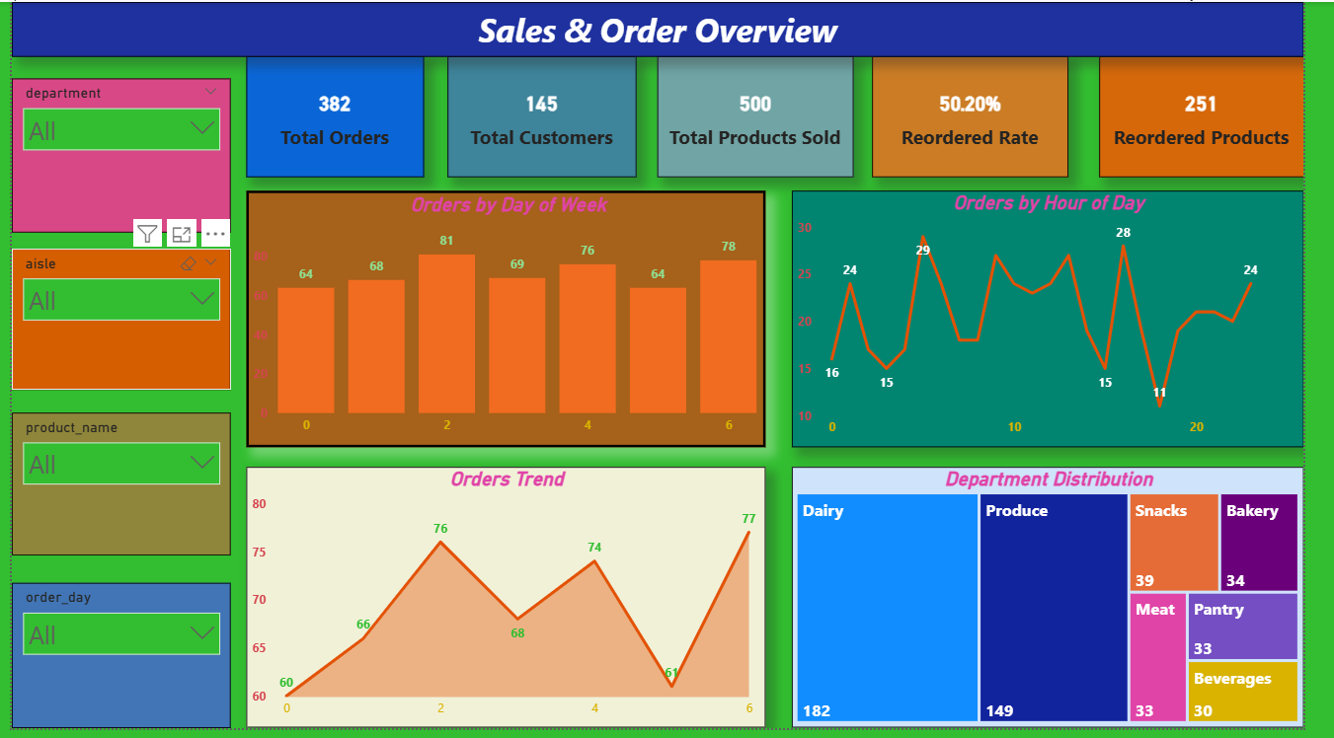
Result: Page 1 — Sales and Order Overview
Visualizations created: Identifies peak order times and high-demand departments.

Slide 8
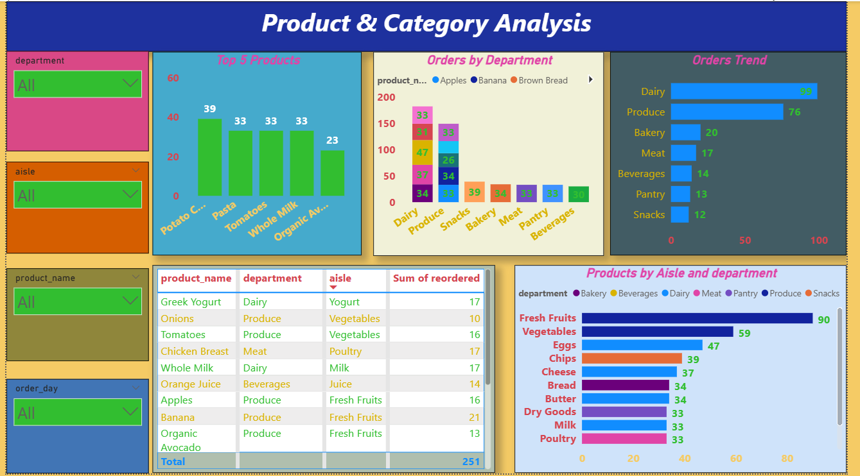
Result: Page 2 — Product and Category Analysis
Visualizations created: Helps identify best-selling products and popular grocery categories.

Slide 9
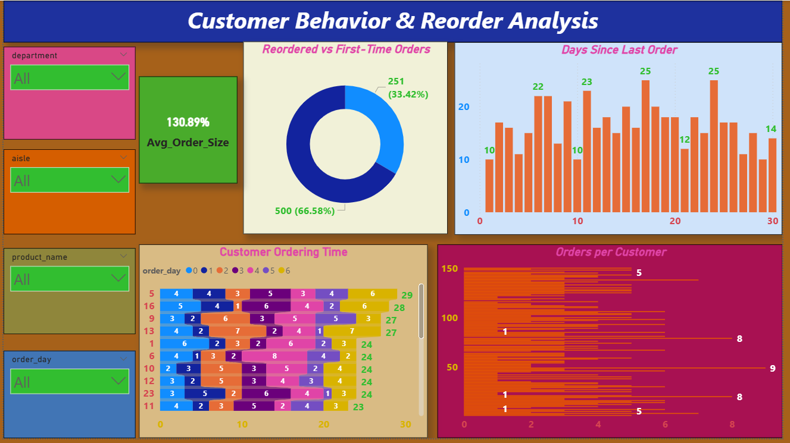
Result: Page 3 — Customer Behavior and Reorder Analysis
Visualizations created: Analyzes customer purchasing behavior and loyalty patterns.

Slide 10
Conclusion:
This project successfully developed a Power BI dashboard to analyze Instamart grocery order data.
The dashboard provides important insights such as:
Peak order times during the day
Most popular grocery departments
Best-selling products
Customer reorder behavior
Customer purchase frequency
By using interactive visualizations and DAX calculations, the system helps businesses make data-driven decisions related to inventory planning, marketing strategies, and customer experience improvement.
Overall, the Power BI dashboard improves the ability to analyze large datasets and transform raw data into meaningful insights.

Slide 11
Future scope:
The project can be further enhanced by implementing the following improvements:
Integration of real-time order data
Advanced customer segmentation analysis
Product recommendation systems
Sales forecasting using machine learning models
Integration with other business analytics platforms
Future enhancements can help Instamart improve demand forecasting, customer targeting, and operational efficiency.

Slide 12
References:
Instacart Online Grocery Basket Analysis Dataset – Kaggle.
Microsoft Power BI Documentation.
Data Visualization Best Practices – Microsoft Learn.
Drive Link: https://drive.google.com/drive/folders/1qLn1iXit-ltkJVQMawddKArBo52GPKRF?usp=sharing
GitHub Link: https://github.com/Shivacharan16/Instamart-Sales-and-Customer-Behavior-Analysis-using-Power-BI

Slide 13
Thank You

